Slide 1
How to Register as a Volunteer
info@ayso60.org
AYSO Region 60

Slide 2
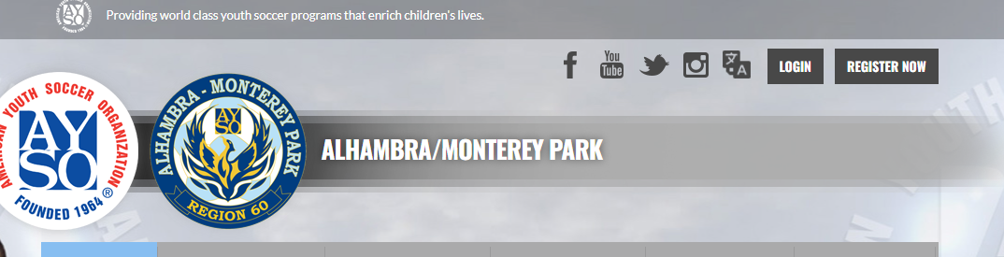
Register at https://www.ayso60.org

Slide 3
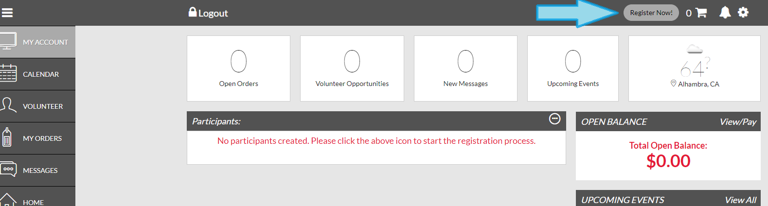
Click “Register Now”

Slide 4
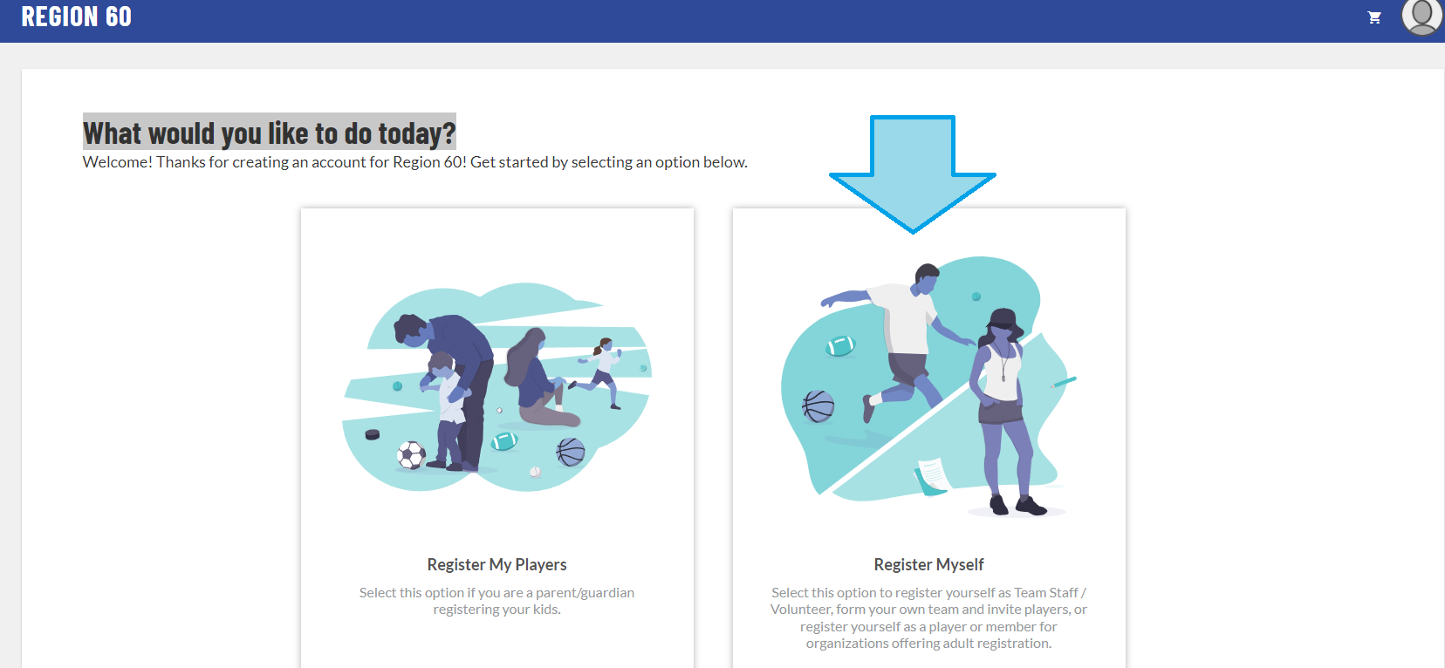
Click “Register Myself”

Slide 5
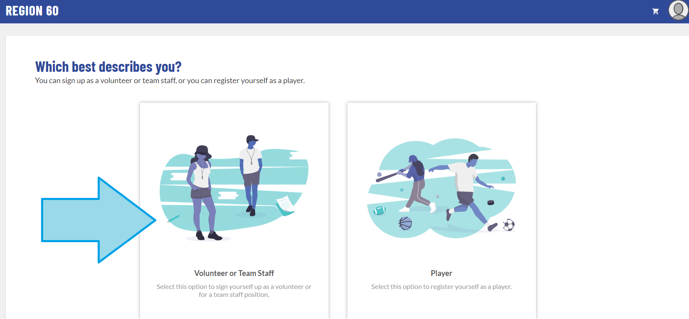
Click “Volunteer or Team Staff”

Slide 6
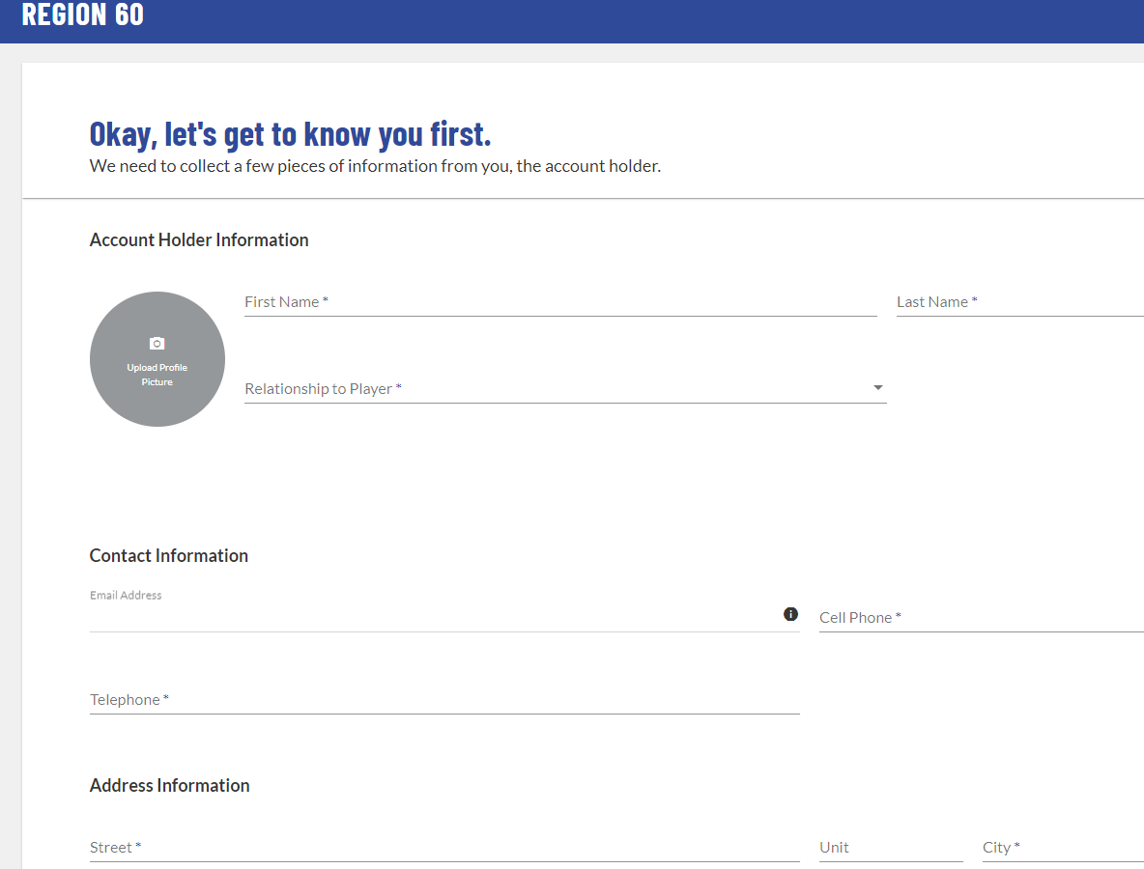
Fill in contact information
Upload photo of yourself
If you do not have a player in the region select “other” under relationship to player

Slide 7
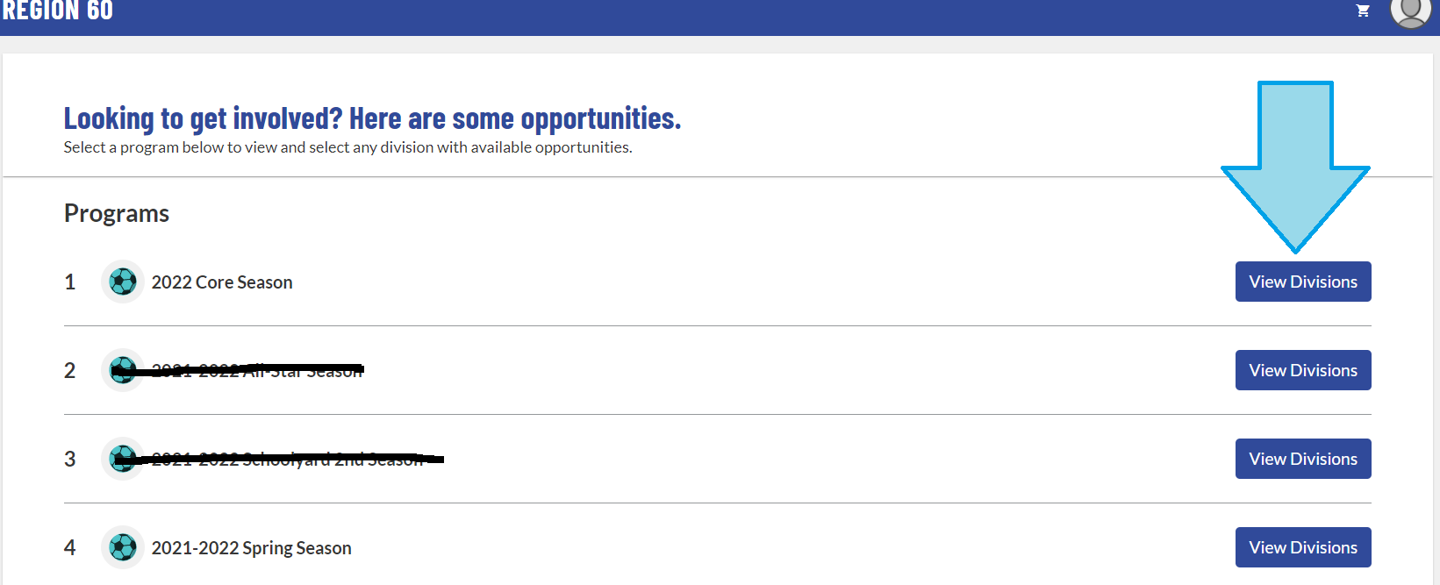
Select the season you are registering for:
Click “View Division”

Slide 8
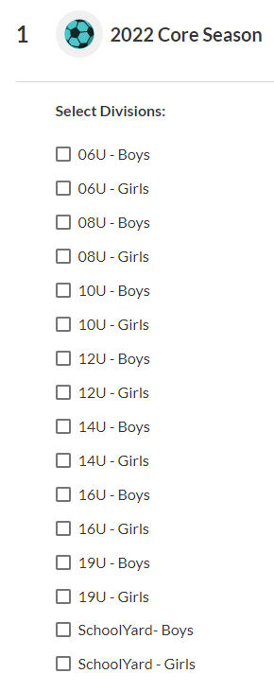
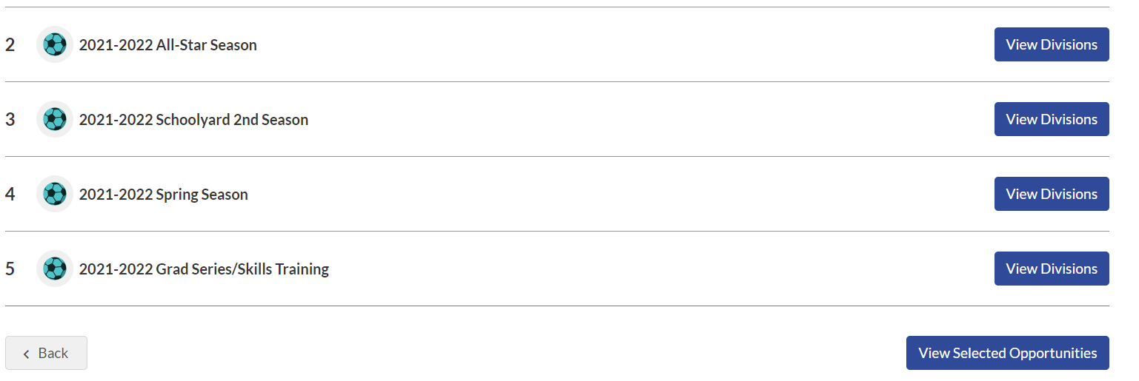
Select a Division
Scroll down and click “View Selected Opportunities”

Slide 9
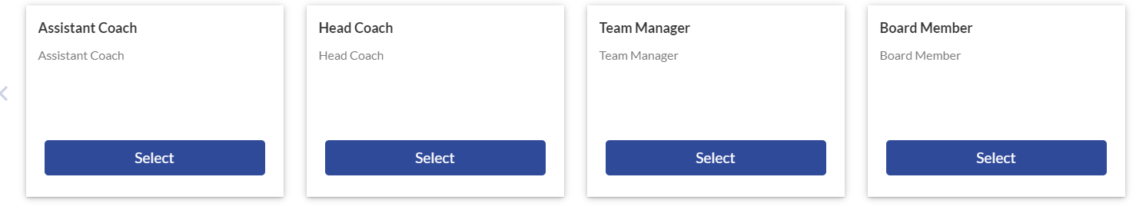
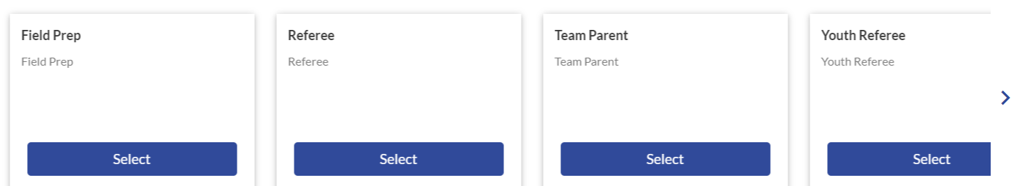
Select Volunteer Role:

Slide 10
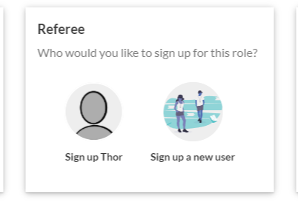
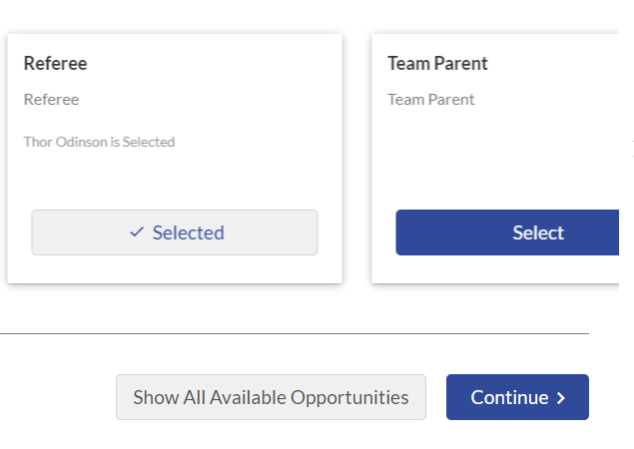
Select user to register for the volunteer role:

Slide 11
Complete your registration:
*****Driver’s License Number & Social Security Number are REQUIRED*****
View/Accept the waivers
Select Continue

Slide 12
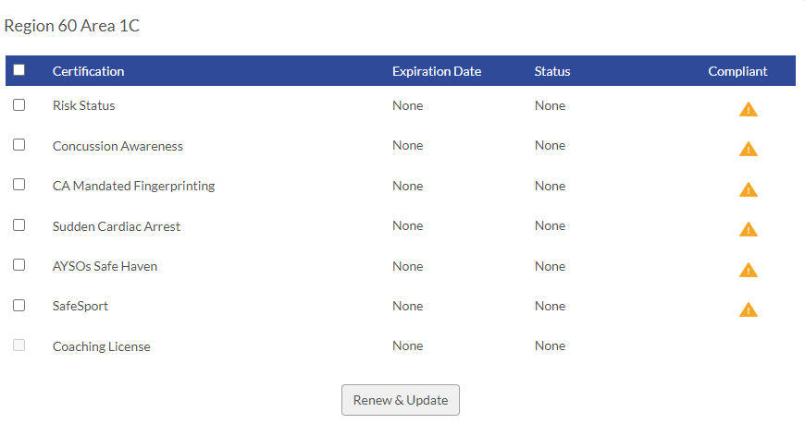
COMPLETE ALL REQUIREMENTS

Slide 13
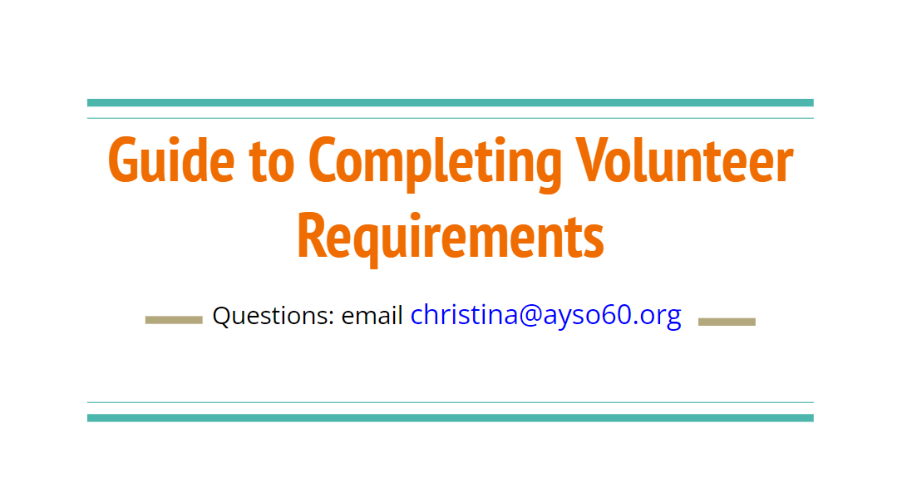
Proceed to the Guide to Completing Volunteer Requirements
Guide to Completing Volunteer Requirements - Google Slides
Janet@ayso60.org

